Slide 1



ASSIGNMENT 1
Study of ETL Tools
EXCEL
Group 12
C021 - Pearl Parikh
C049 - Chahel Gupta
C054 - Divy Beel
C055 - Sonia Mascarenhas

Slide 2


INDEX
01
Introduction
02
Accessibility
03
Supported data format
04
Major features for extraction and processing
05
Data visualization features
06
Ways of data export

Slide 3


WHAT IS EXCEL?
Microsoft Excel is a widely used spreadsheet application developed by Microsoft.
Excel is primarily designed for tasks related to data manipulation, analysis, and visualization, making it a powerful tool for a wide range of users, including businesses, researchers, educators, and individuals.
Its versatility and user-friendly interface make it a versatile tool for a wide range of tasks involving data management and analysis.

Slide 4
ACCESSIBILITY
EASY ACCESS ANYWHERE
COMPATIBILITY WITH DIFFERENT SOFTWARE
EXCEL ON YOUR PHONE
Microsoft offers Excel mobile apps for iOS and Android devices.
With the Excel mobile app, users can view, edit, and create spreadsheets on the go.
Real-time collaboration is also available in the mobile app, allowing users to work together remotely.
Excel can be accessed from virtually anywhere using a variety of devices, including computers and mobile devices.
Users can access their Excel files stored in the cloud and collaborate with others in real time, regardless of their location.
Excel is highly compatible with other software applications and file formats.
It supports the import and export of data in various formats, such as CSV, TXT, PDF, and more, enabling seamless data exchange with different platforms and tools.

Slide 5

SUPPORTED DATA FORMATS
EXCEL WORKBOOK
CSV
TSV
TEXT (TAB-DELIMITED OR COMMA-DELIMITED)
XML
JSON
ACCESS DATABASE
SQL SERVER DATABASE
HTML
ODBC
POWER QUERY/GET & TRANSFORM

Slide 6

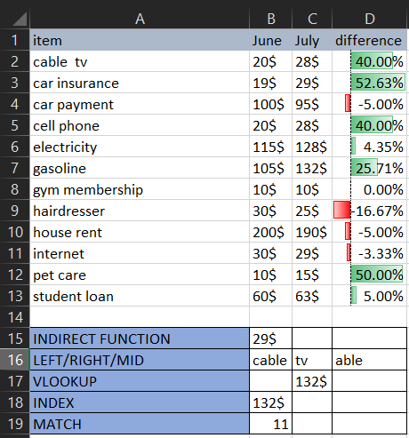
MAJOR FEATURES FOR EXTRACTION
INDIRECT
Returns the value of a cell specified by a text string.
DATA SET
LEFT/RIGHT/MID
Extracts text from specified positions within a text string.
VLOOKUP
Retrieves data from table based on first-column match.
INDEX
Retrieves value from
specific row & column in a range.
MATCH
Finds the position of a specified value in a range.

Slide 7
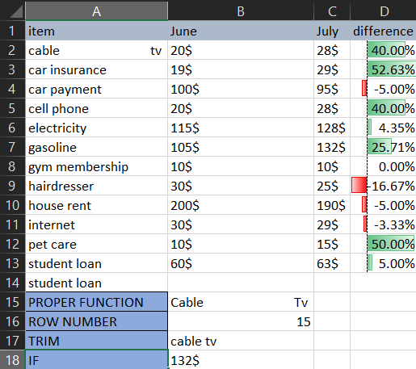


MAJOR FEATURES FOR PROCESSING
DATA SET
PROPER
Capitalizes the first letter of each word in a text string.
TRIM
Removes extra spaces from a text string, leaving only single spaces between words.
ROW
Returns the row number of the cell where the formula is used in Excel.
IF
Performs a conditional check
and returns one value if the
condition is true and another if false.

Slide 8
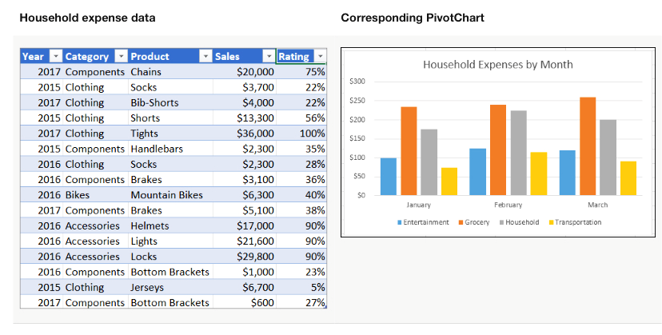


DATA VISUALIZATION FEATURES
PIVOT CHARTS
Entertainment
Grocery
Transportation
Household
Pivot charts are graphical representations of data from a PivotTable, allowing you to visualize and analyze data dynamically.
They help you quickly understand and explore data trends, patterns, and relationships within a PivotTable.
250
1
200
150
100
2
50
0
January
February
March

Slide 9

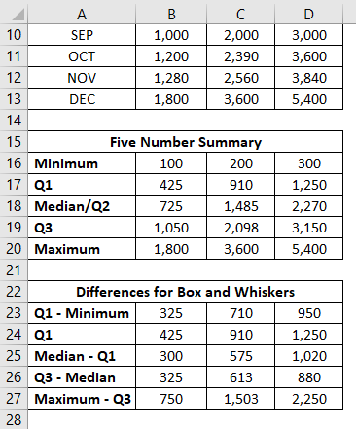
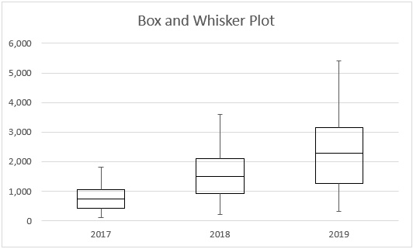
BOX PLOT
Box plots display data distribution, with the box indicating the middle 50% (IQR) and the line inside
denoting the median.
Whiskers extend to data's minimum and maximum values within a specified range.
1
2

Slide 10
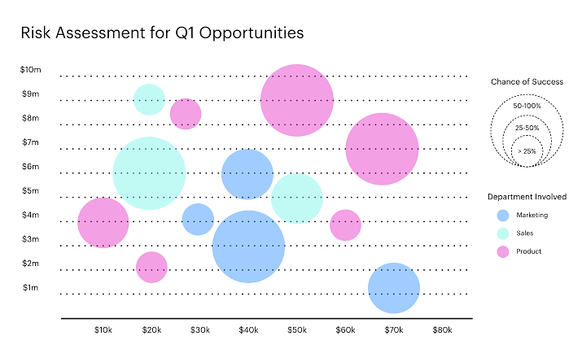
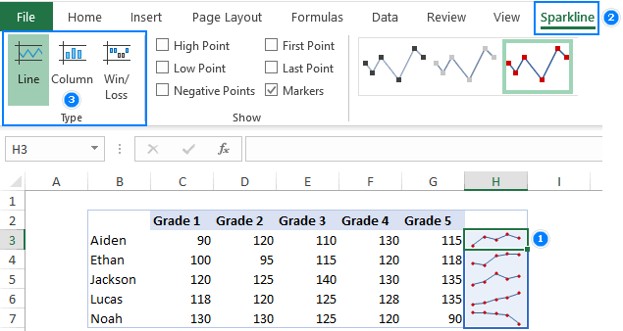
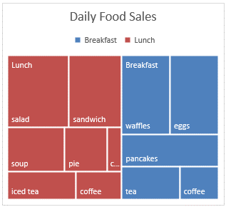
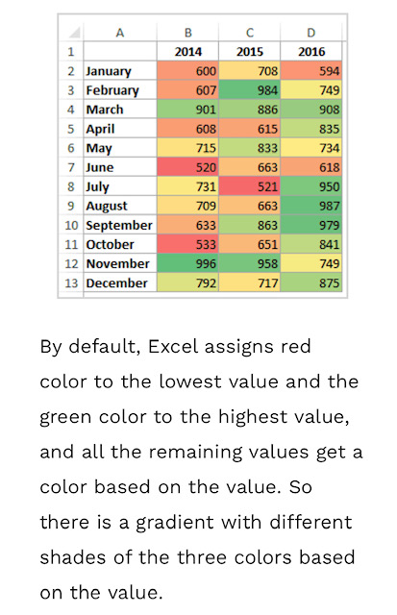
BUBBLE CHART
SPARKLINES
Represent multi-dimensional data with varying-sized bubbles
Unusually large or small bubbles can highlight data outliers or anomalies, drawing attention to exceptional data points..
Sparkline charts are miniature, condensed charts or graphs that fit within a single cell in an Excel worksheet.
Sparkline charts can be customized by adjusting type, style, and markers for data emphasis.
ADVANCE CHARTS
TREE MAPS
HEAT MAPS
Hierarchical charts with nested rectangles for visualizing structured data.
Tree maps use color-coded rectangles for clear data value representation across hierarchy levels.
Color-coded grids for visualizing data patterns and variations.
Facilitate quick identification of data patterns and trends through color intensity, making complex data more accessible.

Slide 11
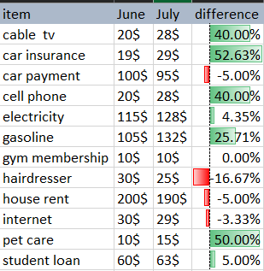
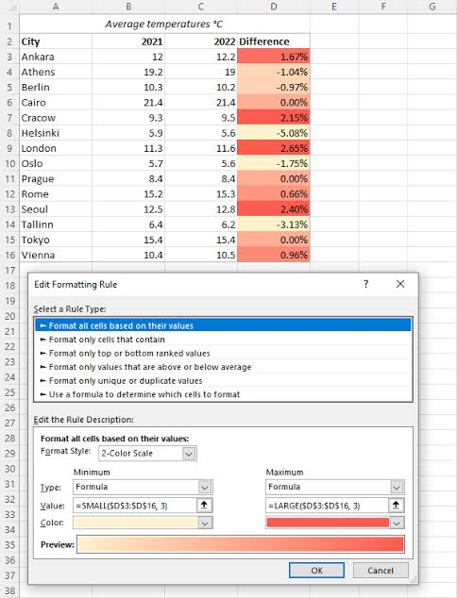
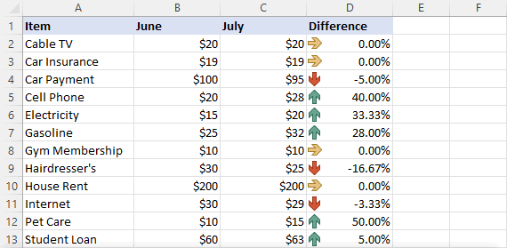
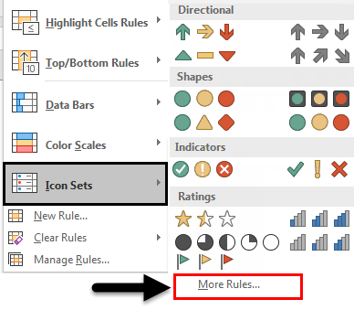
CONDITIONAL FORMATTING
Use of formatting rules to visually enhance and highlight specific data points or patterns in a dataset, making it more accessible and insightful for analysis.
DATA BARS
COLOR SCALES
ICON SETS
Represent data values with horizontal bars within cells.
Apply color gradients to cells based on data values.
Use icons to visually convey data conditions or trends.

Slide 12

WAYS OF
DATA EXPORT
EXCEL WORKBOOK
PDF
CSV
TEXT
HTML
XML
SQL DATABASE
WORD, POWERPOINT,OUTLOOK
SEND AS EMAIL
ONEDRIVE/SHAREPOINT
POWER BI
WEB QUERY
POWER QUERY (GET & TRANSFORM)
CUSTOM VBA MACROS
POWER AUTOMATE

Slide 13

THANK YOU
DATA EXTRACTION & PROCESSING
Assignment 1 - Study of ETL Tools
Group 12
BTI Computers,
Year IV
Semester VII

